Slide 1
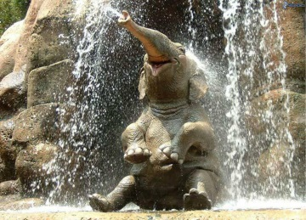
LinkedIn Proficiency
For jobseekers (and any other professionals)

Slide 2
Building Your LinkedIn
Presence
Content
Start with the basics and build
Groups
Connecting with others
Your Profile
Concept

Slide 3
Building Your LinkedIn
Presence
Sharing Content
PROjecting expertise
Start with the basics and build
Groups: Deeper
Connecting: Targeting right people
Your Profile: Who is this?
Concept: Why bother?

Slide 4
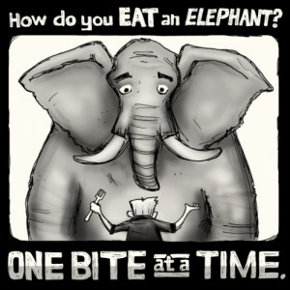
Concept overview
Professional networking
Lifetime investment
Capture and grow your network
You find others first
People find you
PROject your expertise
Give first and more than you get!

Slide 5
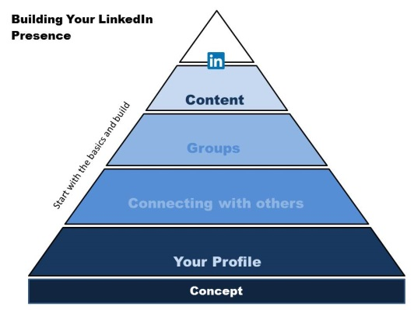
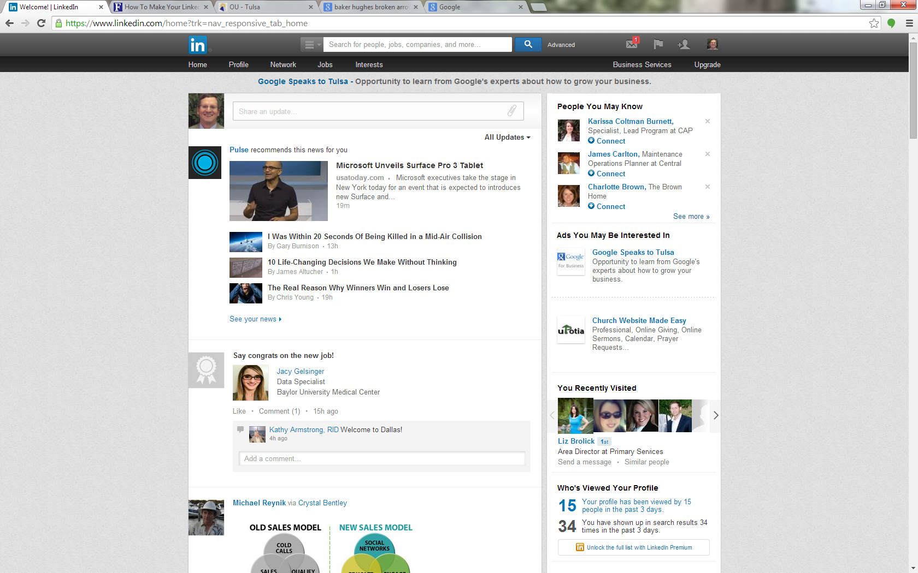
Profile

Slide 6
Key profile components
Headline
Photo
Summary
Experience

Slide 7
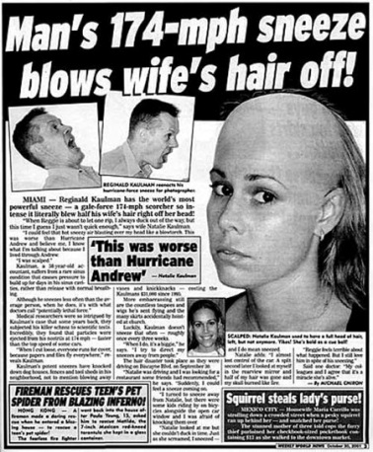
Headline
Most: Current job title + employer
Ex: Accountant II at Williams Co.
Potential: 120 characters of prime real estate
What is best?
What stands out to you?
May add contact info in headline, esp. during job search

Slide 8
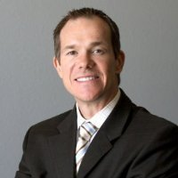
Profile Photo: YES!
Smiling
Professional
Current

Slide 9
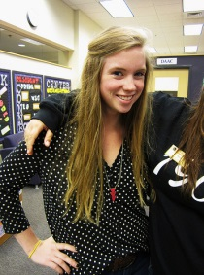
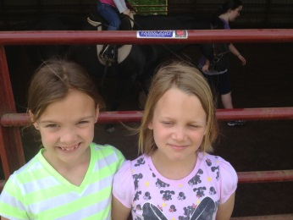
Profile Photo: NO, NO, NO!!
Other bad ideas:
Wedding (too personal) Body shot (not the place for cleavage)
Bling shot (on a boat, with car, etc.)
Not current (20 pounds less, 15 years ago, etc.)
Busy background
Fish pic
Cropped
No smile, blurry
My girls
Unprofessional
Sunglasses + ??
No photo

Slide 10
Summary
Four score and…be brief!
What problem do you solve?
short paragraphs; break up big blocks!
Bullets
Less is more.

Slide 11
Public Profile URL
/in/ vs. /pub/ in your profile
Customized, shortened URL
Use on:
Resume | Business cards | Email signature
Bad: www.linkedin.com/pub/christine-christy-peterson-rhit-chds-ahdi-f/23/881/782
Good: www.linkedin.com/in/knightruss
See?
Germans love David Hasslehoff, even though he does things like this.

Slide 12
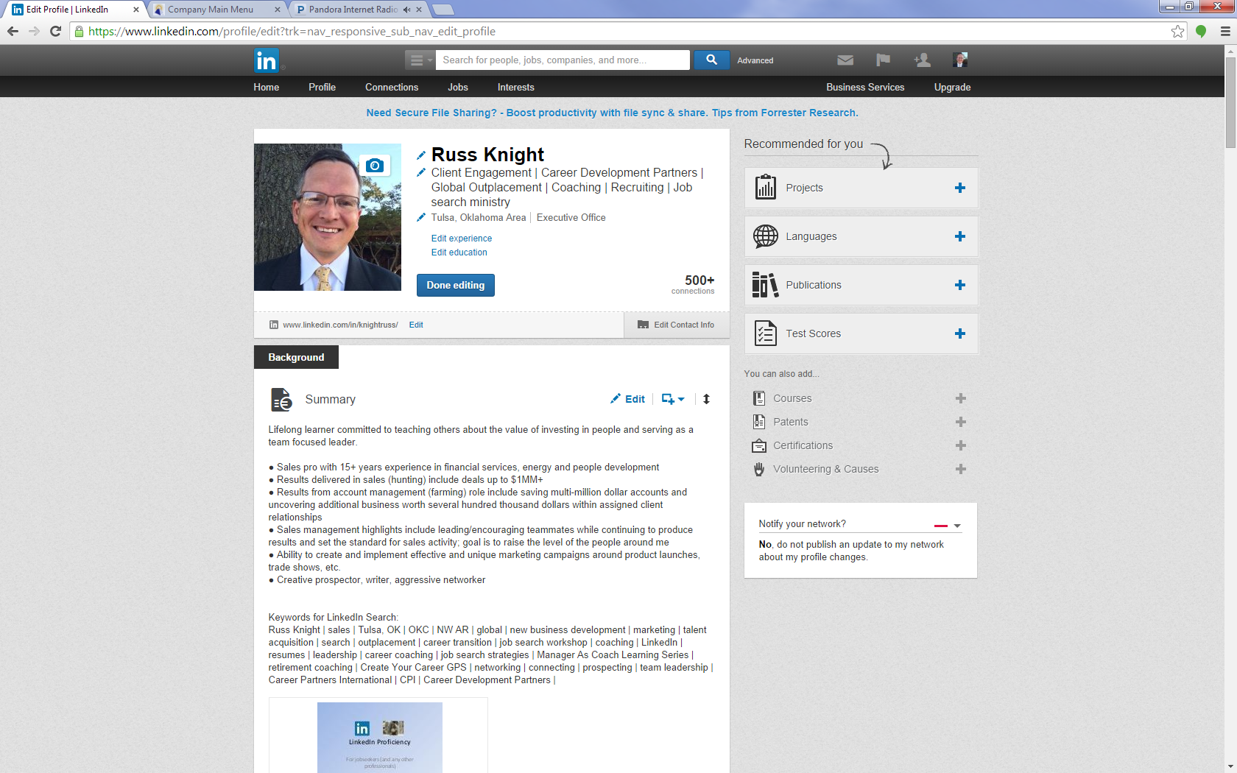
Edit profile, select the “edit” below your photo

Slide 13
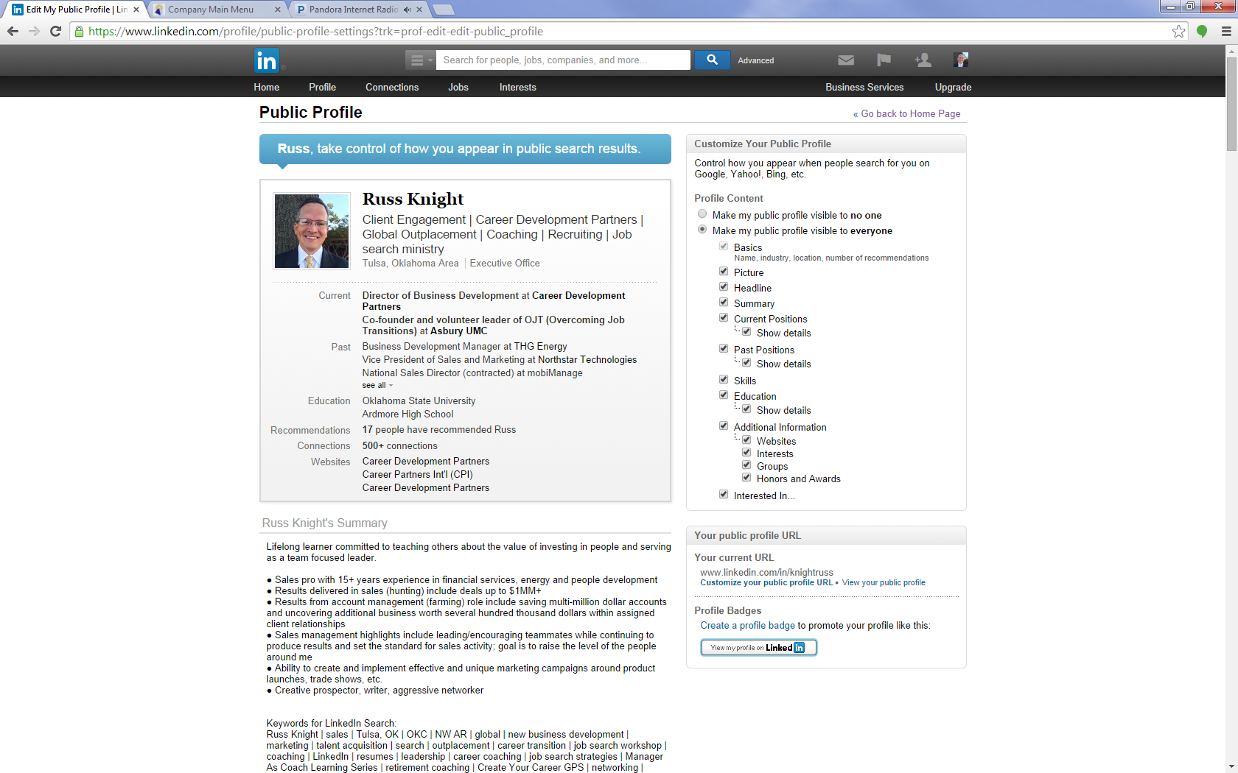
Now, select “Customize your public profile URL”

Slide 14
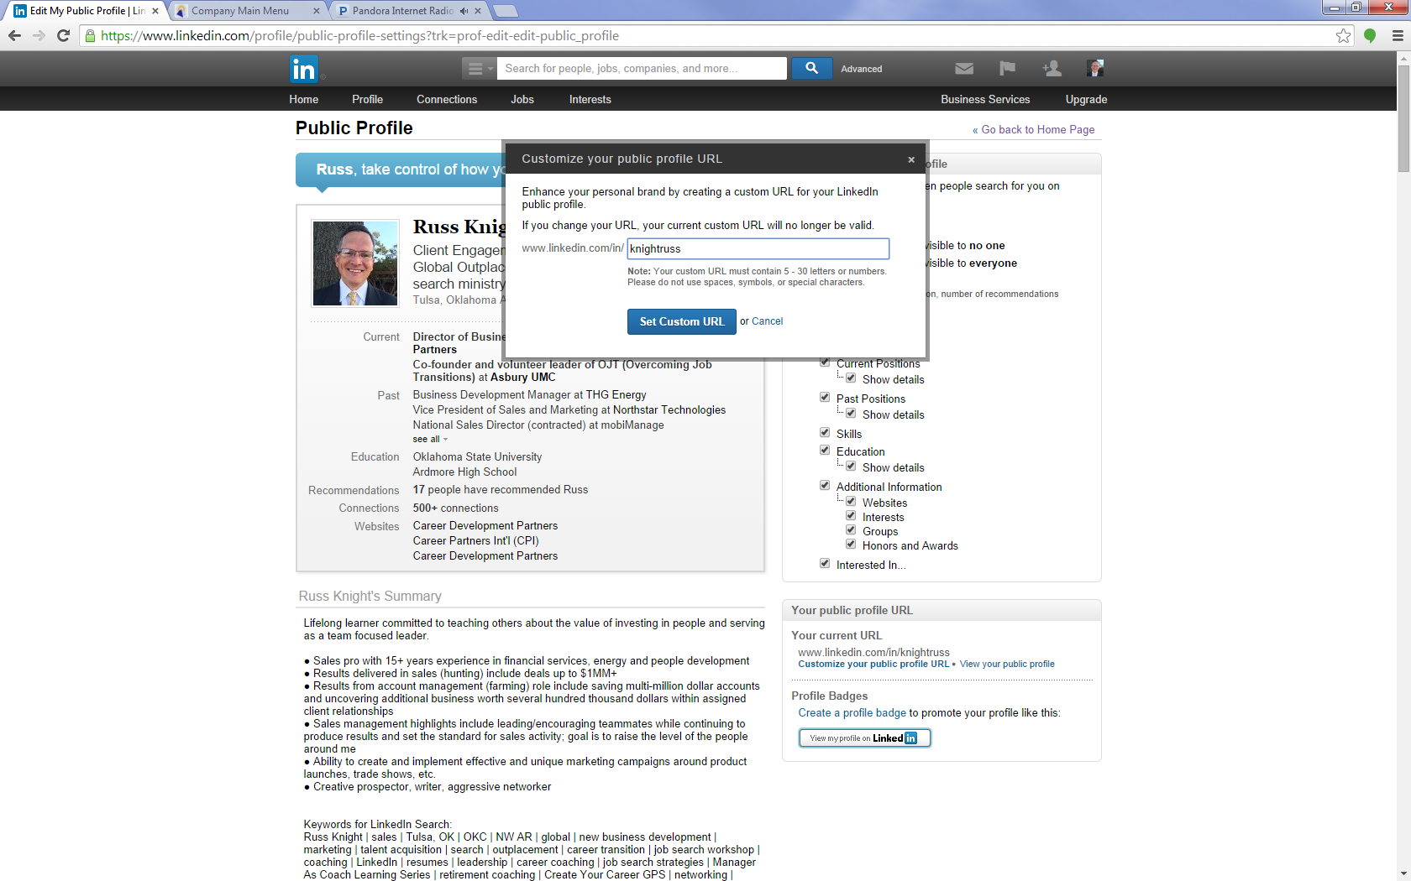
Try until you find one that works

Slide 16
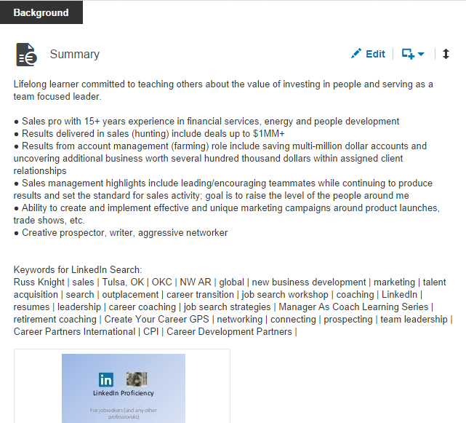
Brief!
A few key points
Enough to get them to keep reading
Heavy use of keywords
Separate keyword section

Slide 17
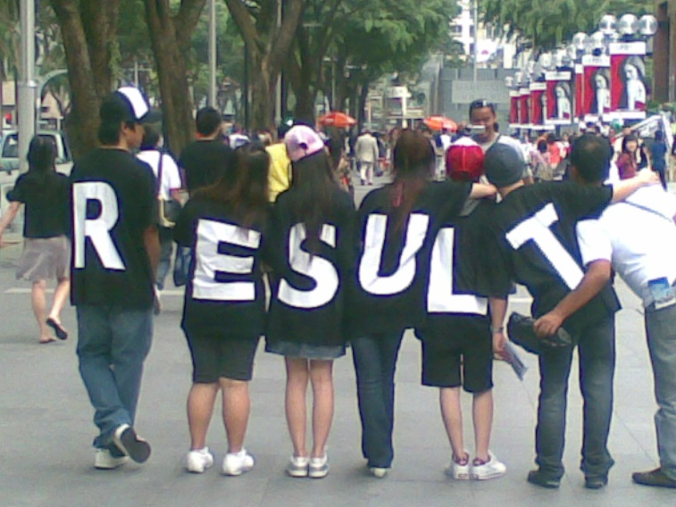
Tell a S+A=R Story
Work history
More than a job description
So what?
Results! $, # and %
Most: I was responsible for sales.
S+A=R Situation + Action = Result
Better: Took over sales in 2003 and after consistent pursuit by phone, mail, email and at events, got a meeting and closed the largest deal the company had gotten in five years worth over $1MM.
One S+A=R per year, if possible.

Slide 18
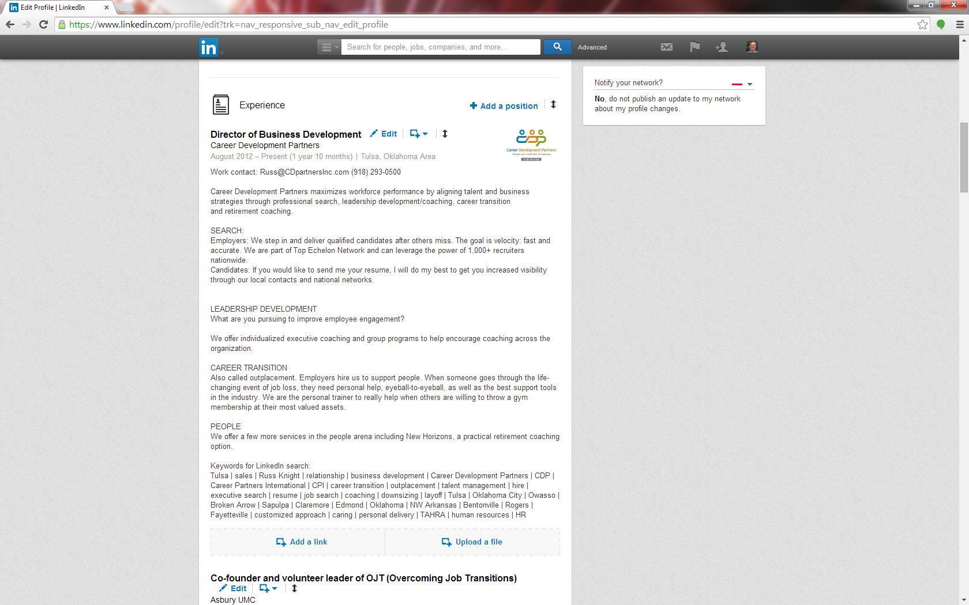

Slide 19
Career Summary “Job”
LinkedIn favors the employed
Are you currently in-between?
Just learned about this in October, 2014
Create a “job” that is an overview of your career
Like this…

Slide 20
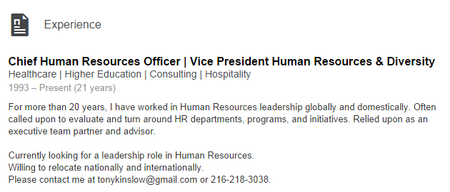
Career Summary “Job”
Create a “job” that covers your entire work experience, then select that as your current work

Slide 21
Work History
Don’t lie; don’t fudge; if you
Ended your work on October 20th, don’t pretend you are currently employed.
2. Avoid confidential numbers;
Even if you included them on your resume
3. Show what you learned; use keywords
4. Be positive

Slide 22
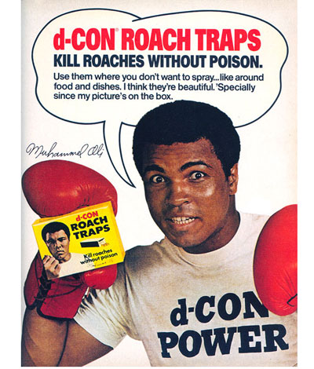
Endorsements?
You list your skills
Connections give one-click “likes”
Nominal value in total
Only endorse for things you have seen

Slide 23
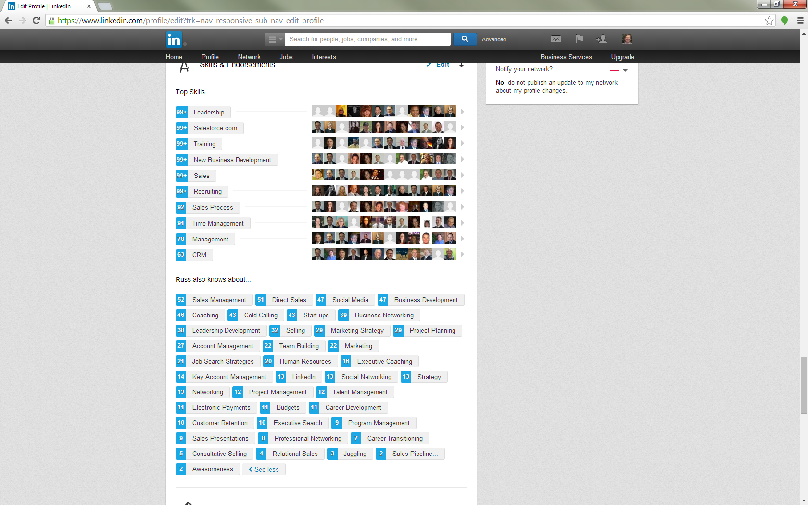
What would you think if I applied for a chemical engineer job??

Slide 24
Recommendations
Testimonial of work history
Who: Bosses, co-workers, employees
Write to get
Length: A paragraph or two

Slide 25
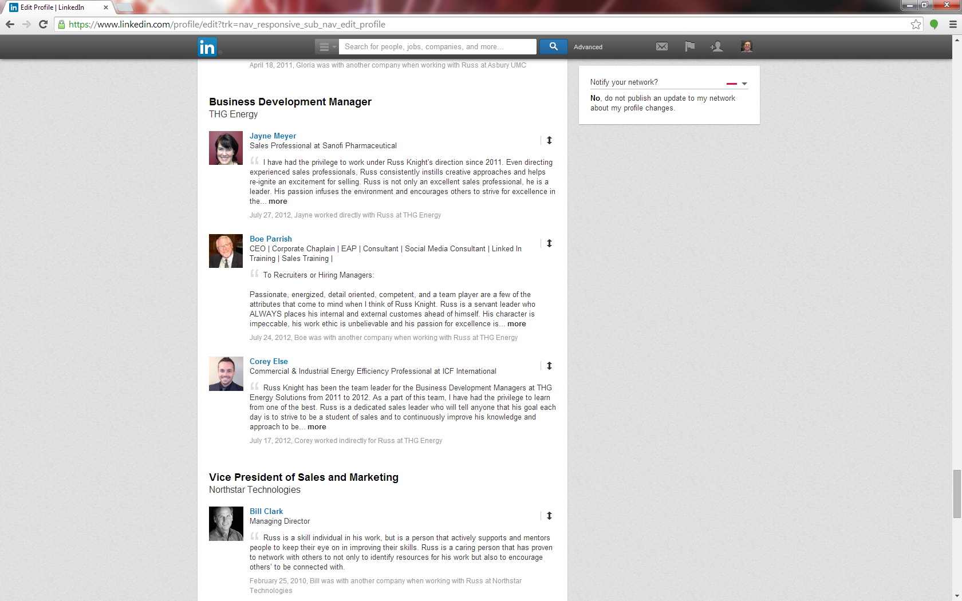

Slide 26
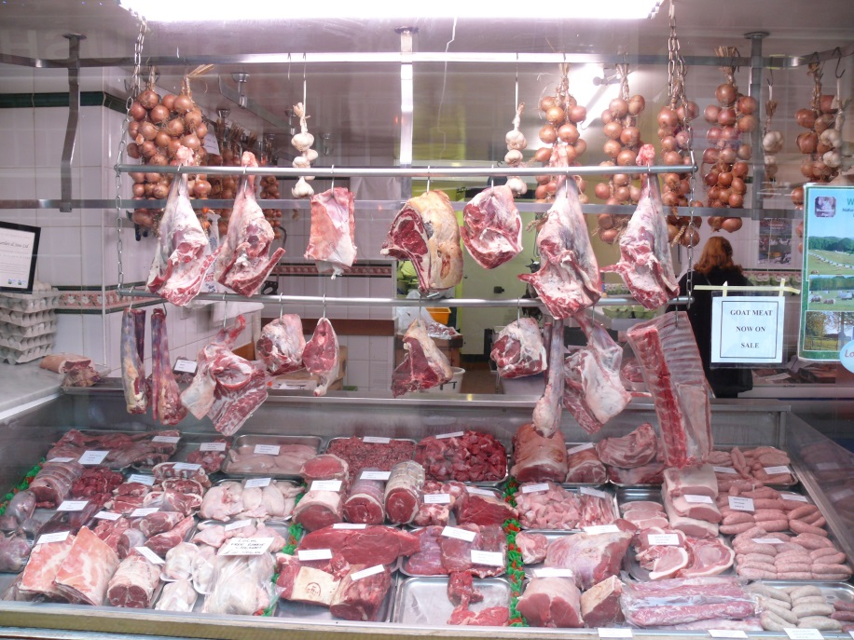
Other Profile Parts
Education
Additional info
Honors & Awards

Slide 27
Education
Did you graduate?
YES: use the words “graduated” and “degree”
NO: tell how many hours you completed
NO: be clear that you did not finish
NO: speak about education
Highlight certifications and other significant courses completed

Slide 28
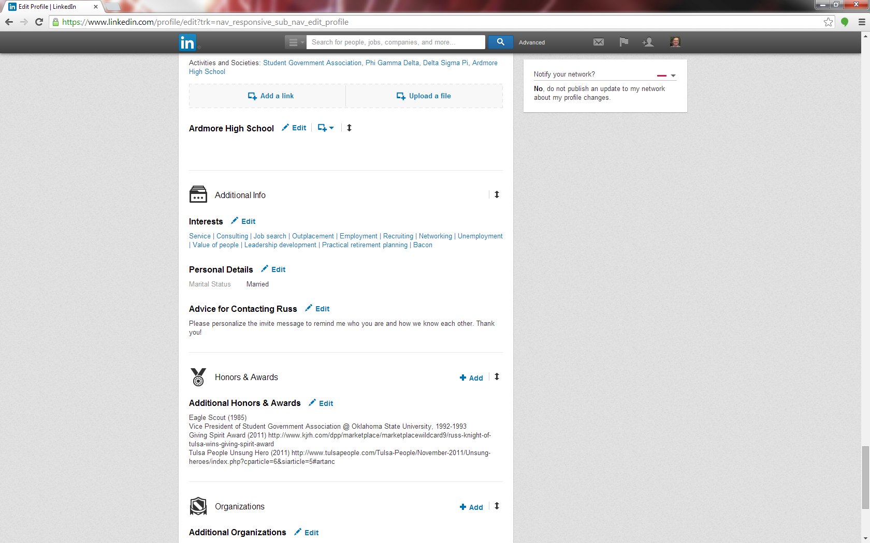
Additional info
Honors & awards

Slide 29
Connecting
Who do you invite?
Who do you accept?
Decide for yourself!
My standard:
Yes: Jobseeker, Tulsa, HR, jobs ministry, recruiters.
No: MLM.
Maybe: 3rd degree out of country.
Connecting more = wider network.
Connecting with all = LION = useful?

Slide 30
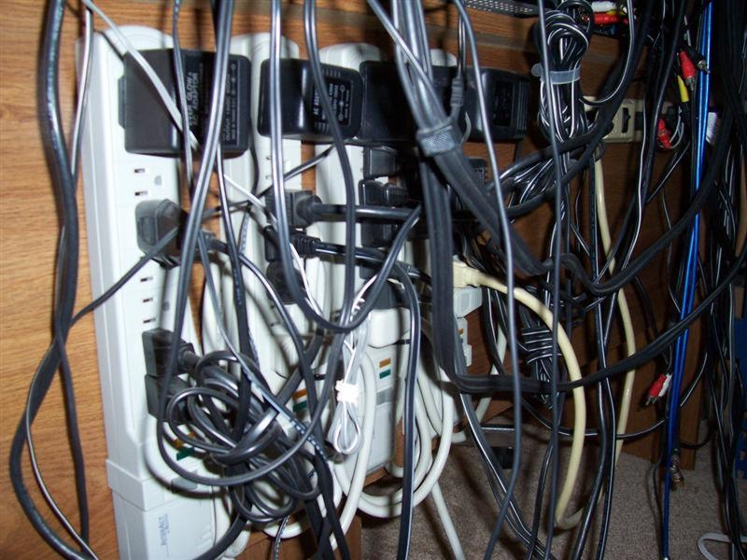
Make the ask
Personalize the invite!
Tell them why you want to connect
Remind them how you met*
Drop the name of a mutual connection*
Ask for help; tell them you are job searching – looking to grow your network

Slide 31
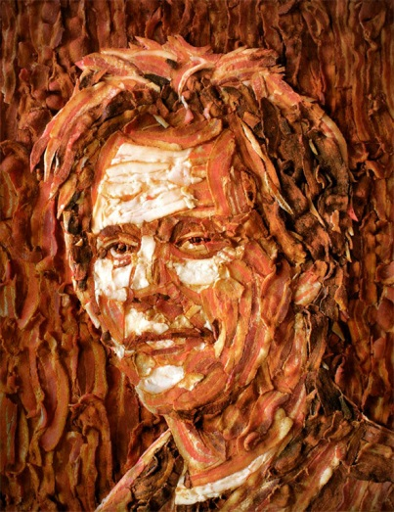
Connecting: Kevin Bacon
How many people do you know?
Answer = X = 1st degree
How many people do they know?
Answer = X² = 2nd degree
How many people do they know?
Answer = X³ = 3rd degree

Slide 32
Kevin Bacon Answers
How many people do you know?
Answer = X = 1st degree
How many people do they know?
Answer = X² = 2nd degree
How many people do they know?
Answer = X³ = 3rd degree
X = 150 X²= 22,500 X³=3,375,000

Slide 33
Groups
Discipline: Sales, HR, engineering, marketing+
Industry: Oil & Gas, public accounting, construction,
health care, manufacturing, non-profit +
Specific: downstream oil & gas, tax accounting, etc.
Trade groups: Tulsa Area Human Resources Assn. (TAHRA), American Bankers Assn. (ABA) +
Geography: Tulsa Networking Professionals +
Interests: Boy scout leaders, chamber volunteers, Habitat for Humanity volunteers +

Slide 34
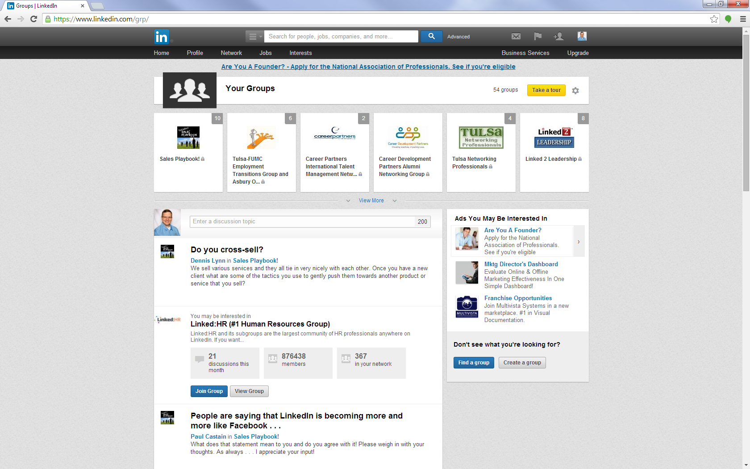
Interests, Groups: This is my “groups” home page. Most active at the top.

Slide 35
Content: Interact first
Before you post, interact with other content FIRST – this is social media
“like” a new job
Comment on a relevant article/post
Share someone else’s update

Slide 36
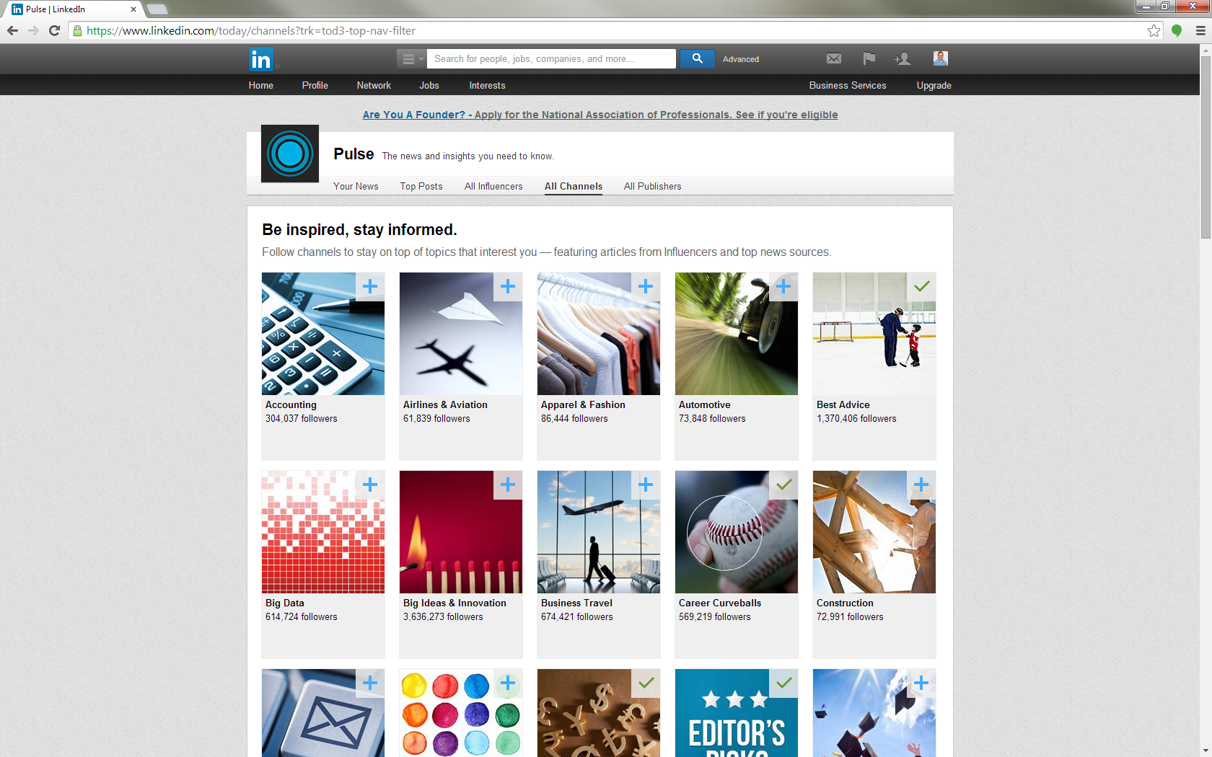

Slide 37
Content: Sources
Harvard Business Review
Inc.com
Forbes
Fast Company
US News
Whitepapers
Blog posts
Tulsa World
Favorite authors
LinkedIn Pulse
Trade associations
Hubspot
Mashable
…and millions more

Slide 38
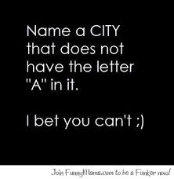
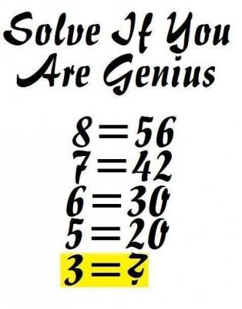
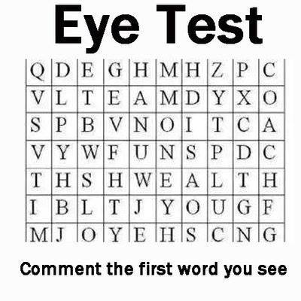
Content: Be a pro
Professional network
None of this *%#& is professional! (neither is profanity) Don’t comment /participate in any of this on LinkedIn – save it for

Slide 39
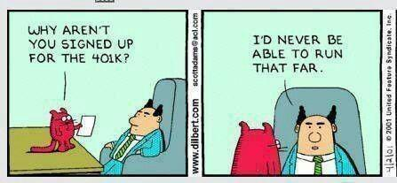
Companies
Companies you have worked for
Potential future employers
Competitors
Prospects
Large employers in my market(s)
Those are the types of companies I follow

Slide 40
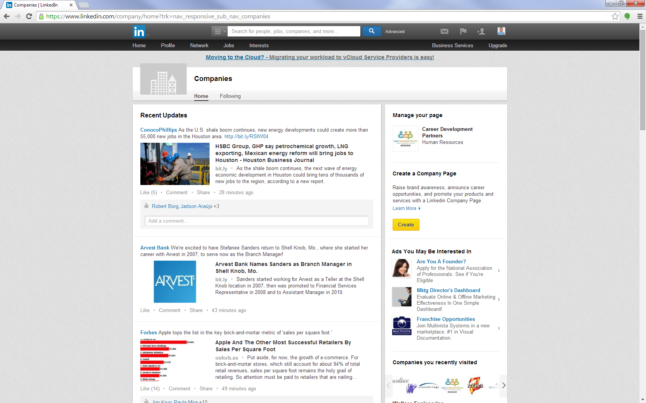
My company news feed

Slide 41
Companies
See who else is following
News source other candidates might not check
Job postings
New hires

Slide 42
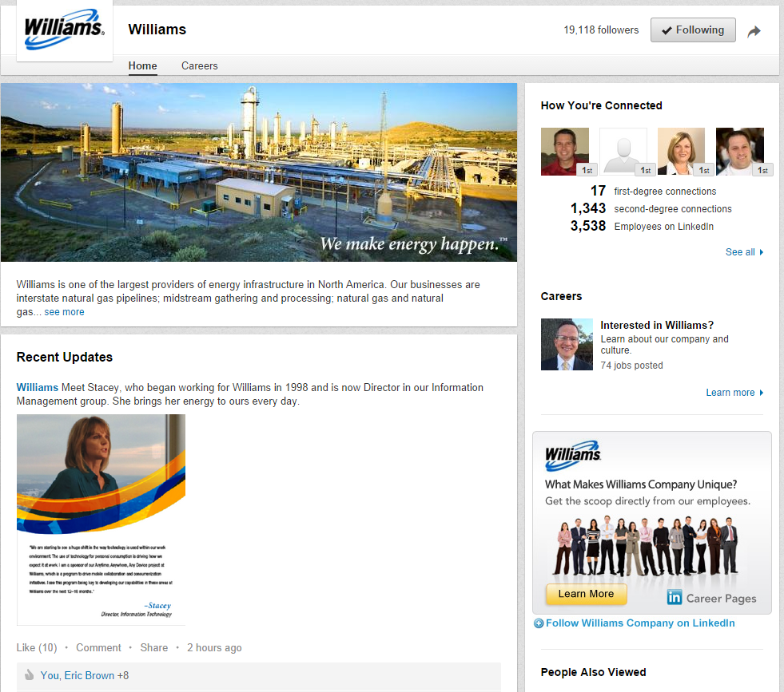
Companies
There is a button on each company page; click to follow.

Slide 43
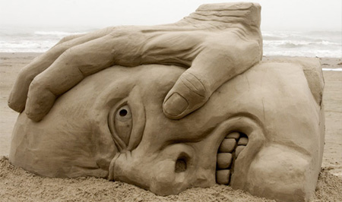
FAQ: How do I…
Change activity broadcasts
Change privacy: what others see when they view my profile, or if I view theirs
Break a connection

Slide 44
FAQ: Change privacy
Want to send updates every time you change your profile?
LI gives you great ability to control privacy settings
Click the small photo of you in upper right corner

Slide 45
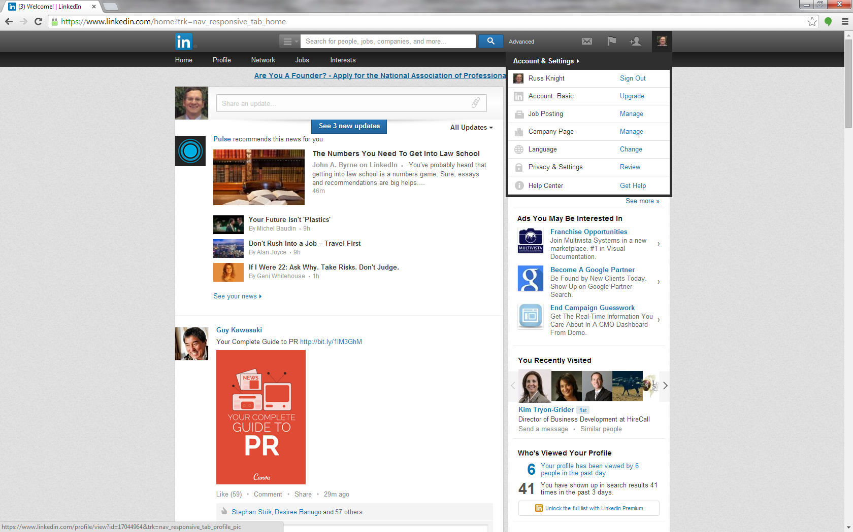
Password required any time you adjust privacy settings

Slide 46
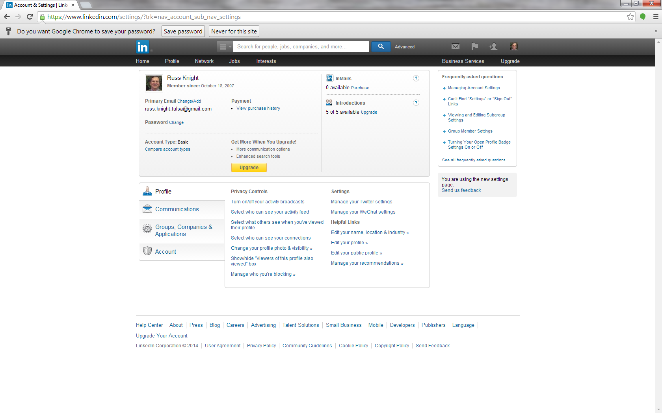
Adjust as you see fit

Slide 47
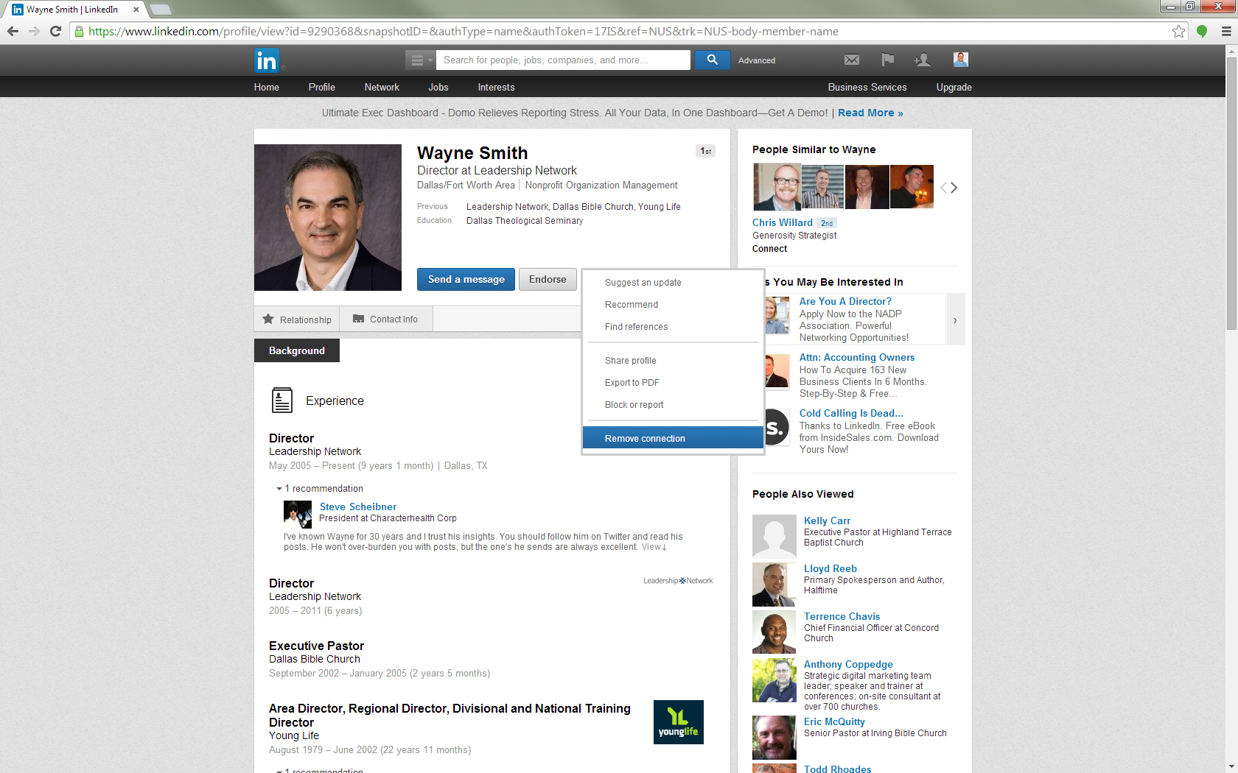
FAQ: Break a connection?

Slide 48
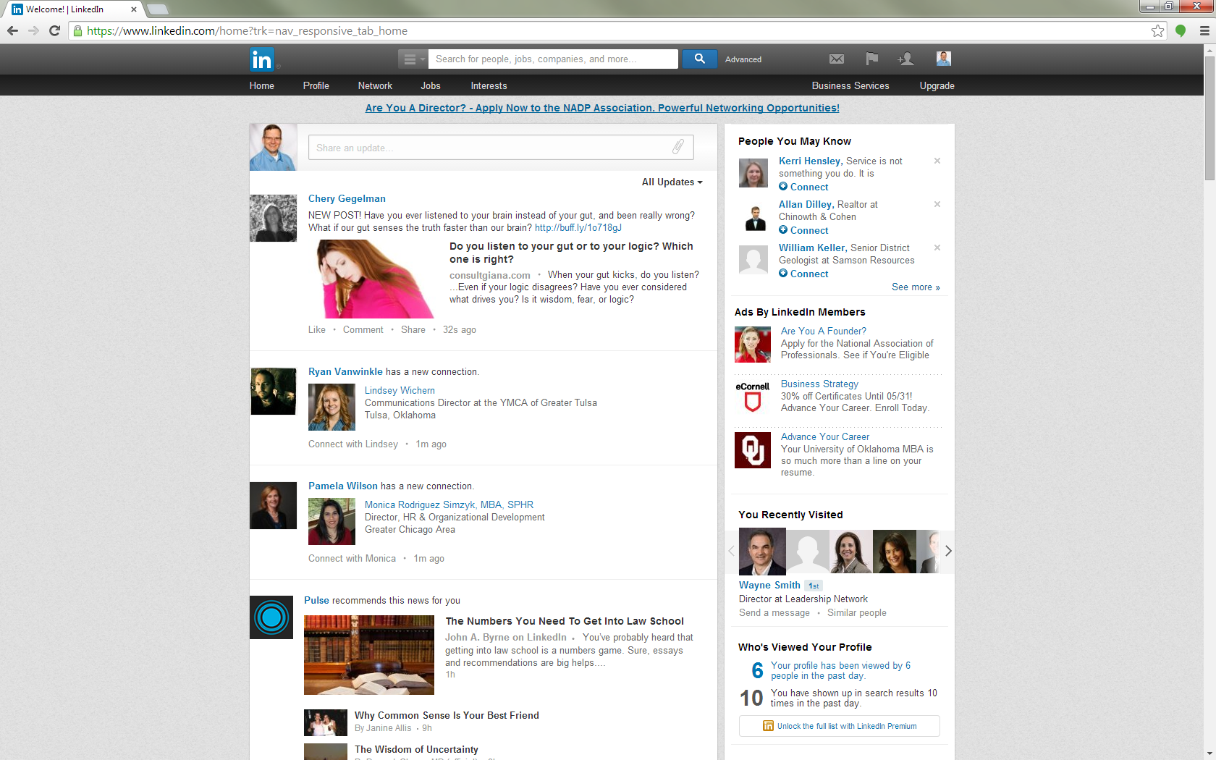
This is my news feed

Slide 49
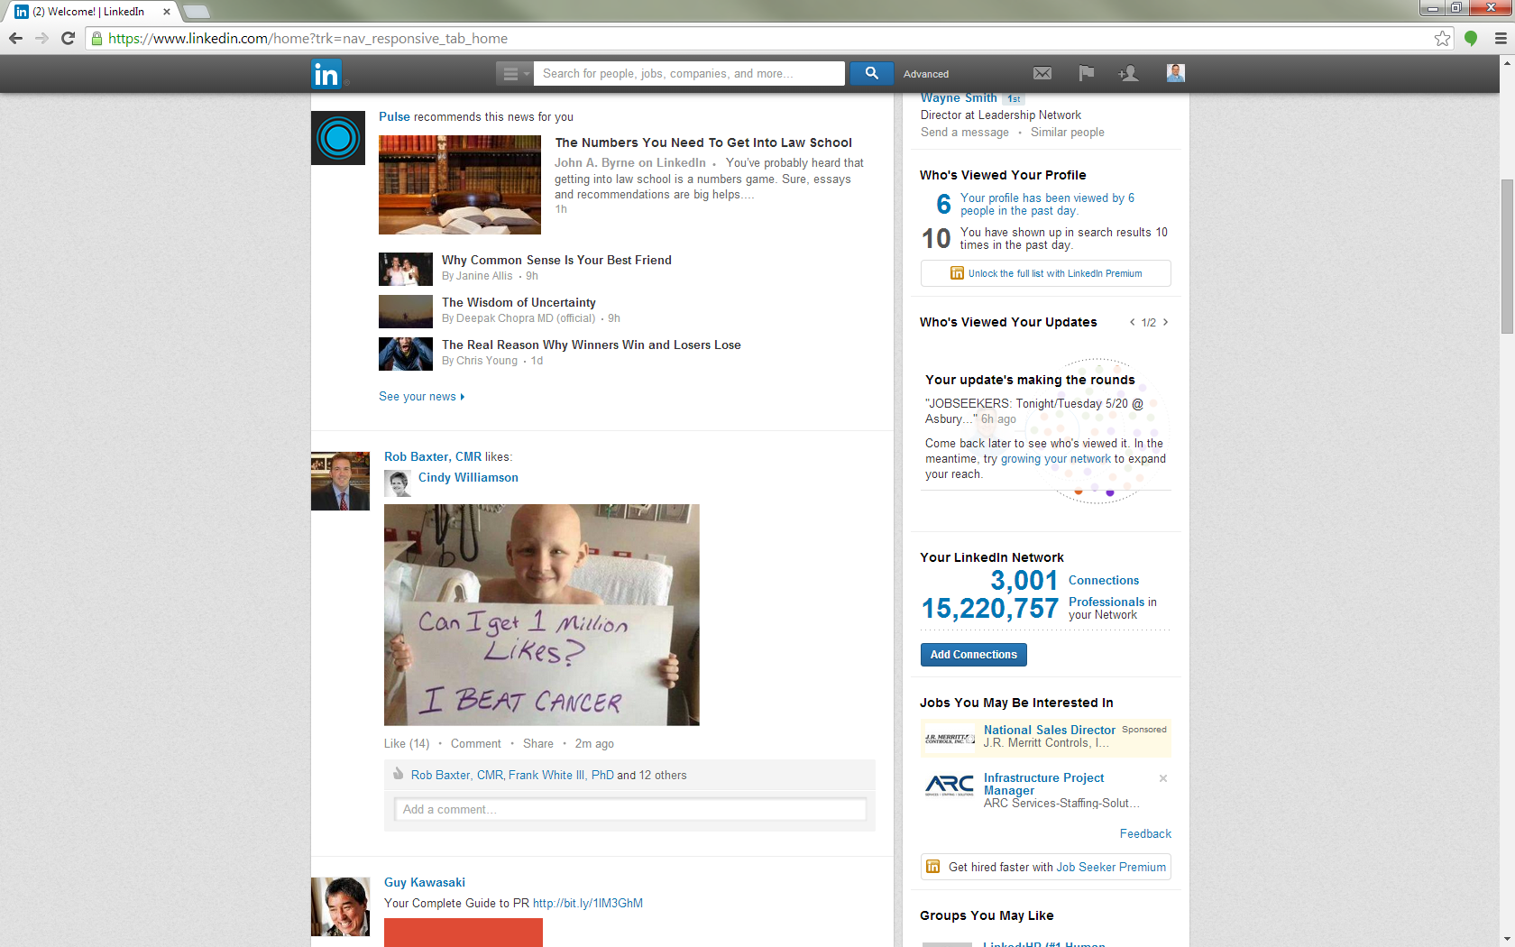
Opinion: I’m as anti-cancer as anyone; but this doesn’t belong on LI. You do what you want…
It goes on forever; as long as I care to scroll

Slide 50
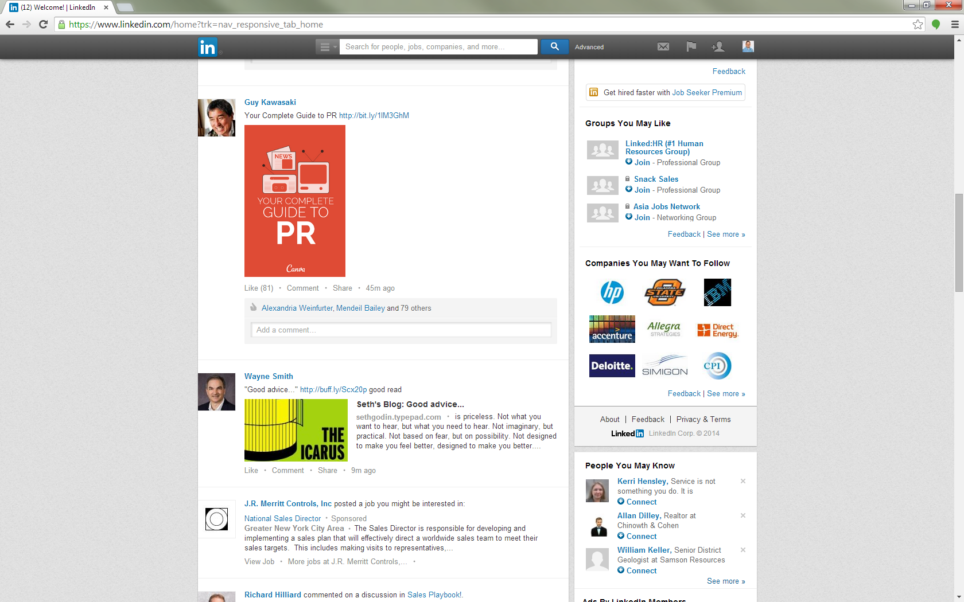
I follow Guy so his posts show in my news feed.
Seth Godin posts good stuff, Wayne is sharing it here…
See?

Slide 51
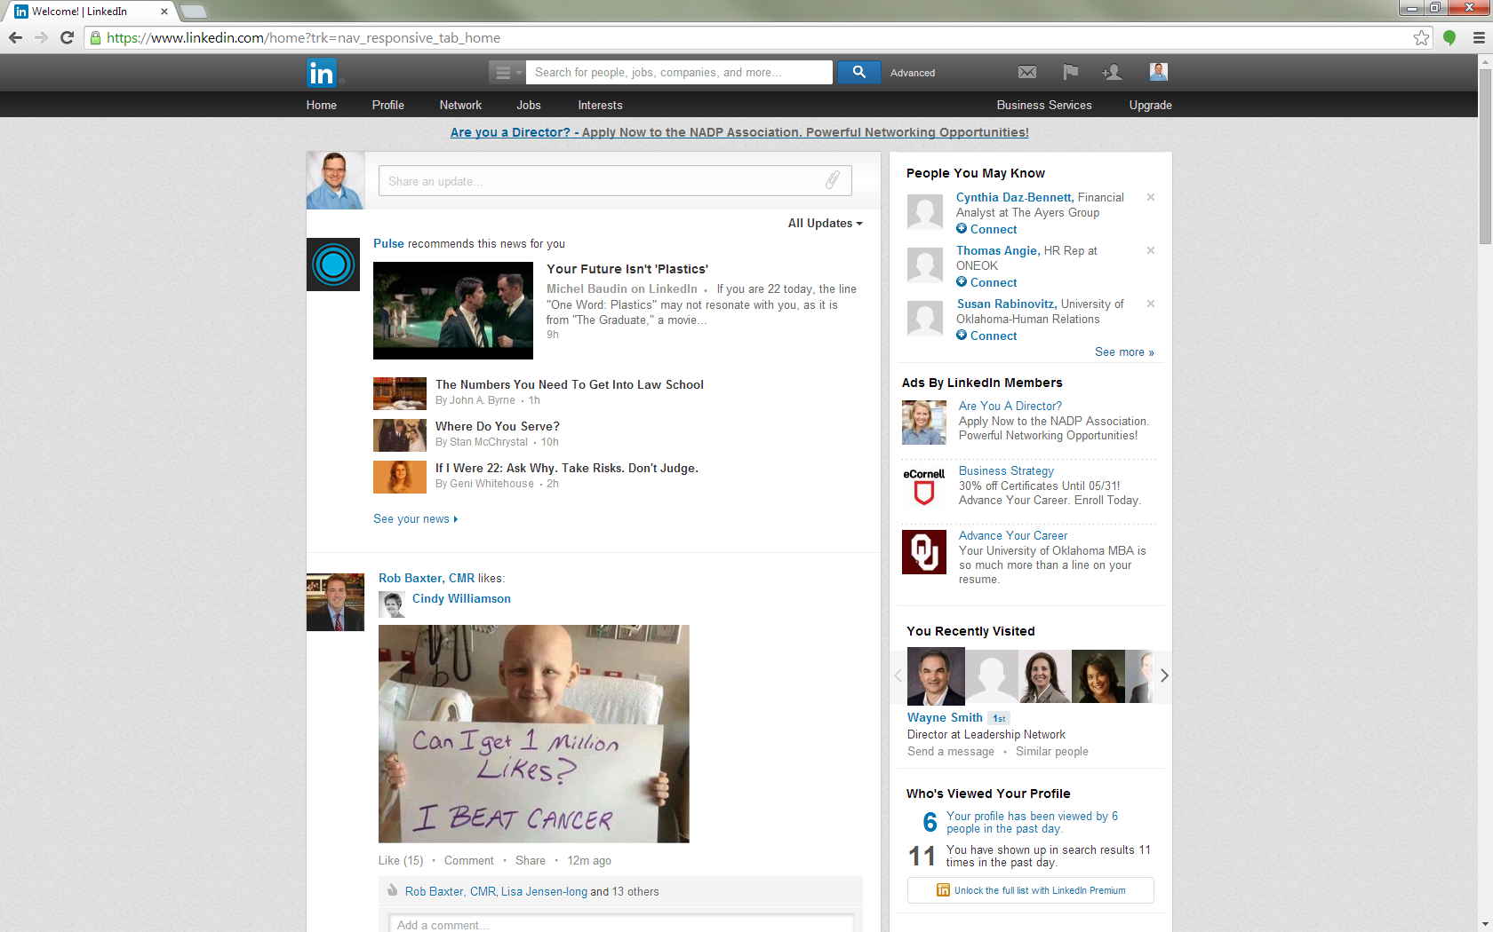
See Pulse here?
Good, customizable news source. Follow relevant topics for you. A/k/a “The beaten path”.
Anyone can find Pulse articles. I get the best interaction from content off the beaten path.

Slide 52
Next steps
What are your key takeaways from this?

Slide 53
LinkedIn Proficiency
The end??
Russ Knight leads business development for Career Development Partners; a search, outplacement and leadership development company in Tulsa also serving OKC , NW AR & the world.
OJTjobs@gmail.com (918) 640-6148

